Slide 1

CSE 491:CLOUD COMPUTING
Introduction & Cloud Definitions
Jannatun Noor
Lecturer,
BRAC University
Jannatun.noor@bracu.ac.bd

Slide 2





Clouds Defined
Cirrus
Cumulus
Cirrocumulus
Altocumulus
Lenticular
Just like many real world, meteorological clouds; a group of defining characteristics make cloud computing systems “Cloud.”

Slide 3
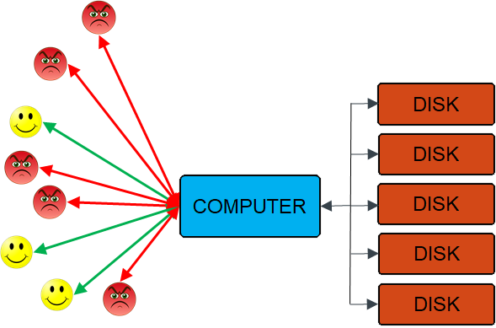
What if Only one Computer?

Slide 4
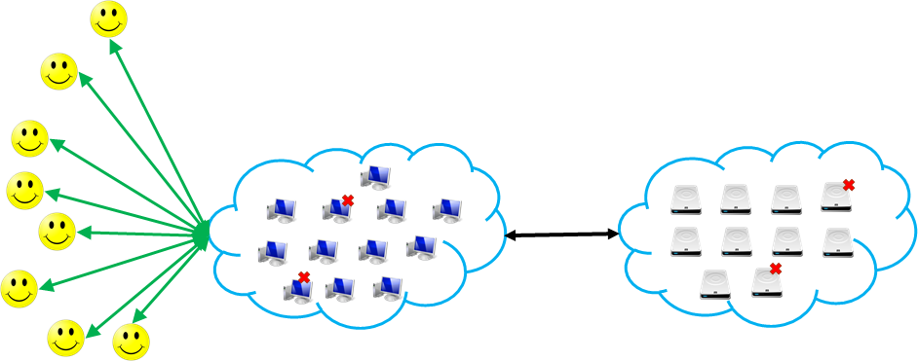
Computers on the internet can satisfy all clients!!

Slide 5
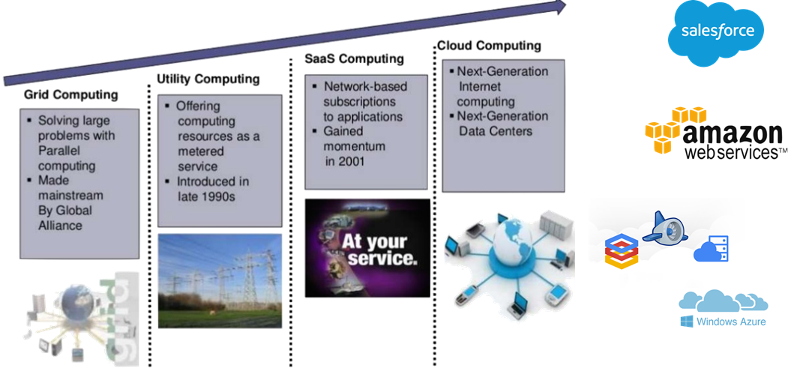
History

Slide 6
Cloud Computing History
In 1999, Salesforce.com started delivering of applications to users using a simple website.
The applications were delivered to enterprises over the Internet, and this way the dream of computing sold as utility were true.
In 2002, Amazon started Amazon Web Services, providing services like storage, computation and even human intelligence.
Only starting with the launch of the Elastic Compute Cloud in 2006 a truly commercial service open to everybody existed.
In 2009, Google Apps also started to provide cloud computing enterprise applications.
In 2009, Microsoft launched Windows Azure, and companies like Oracle and HP have all joined the game.
Notes:
Ref: https://www.javatpoint.com/history-of-cloud-computing

Slide 7
Cloud Computing : Definition
According to the NIST Laboratory,
“Cloud computing is a model for enabling convenient, on-demand network access to a shared pool of configurable computing resources (e.g., networks, servers, storage, applications, and services) that can be rapidly provisioned and released with minimal management effort or service provider interaction.”

Slide 8
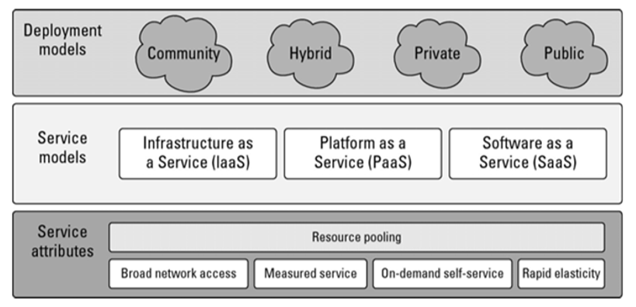
NIST Cloud Definition

Slide 9
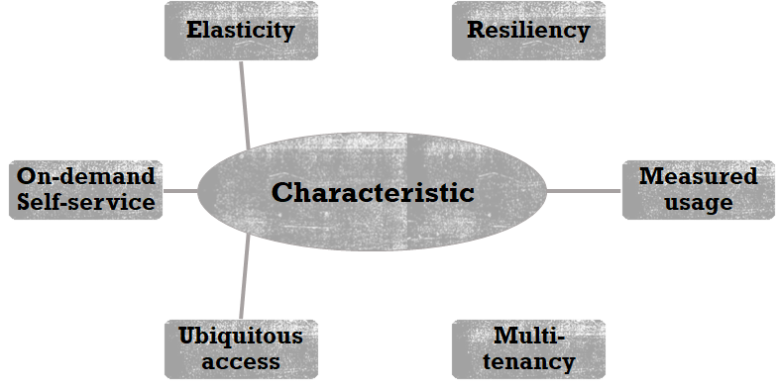
Characteristic

Slide 10
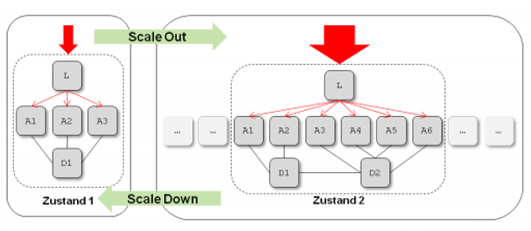
Easticity
Notes:
Resources are provisioned and released on-demand and/or automated based on triggers or parameters.

Slide 11
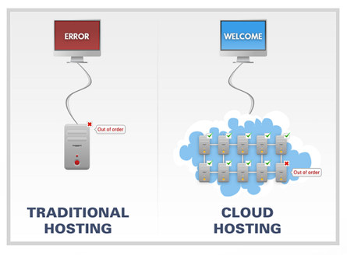
Resiliency
Notes:
Automatically detect and recover from failure.

Slide 12
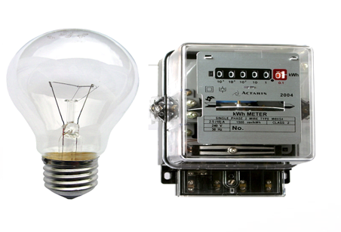
Measured Usage
Notes:
Resource usage are monitored, measured, and reported (billed) transparently based on utilization.

Slide 13
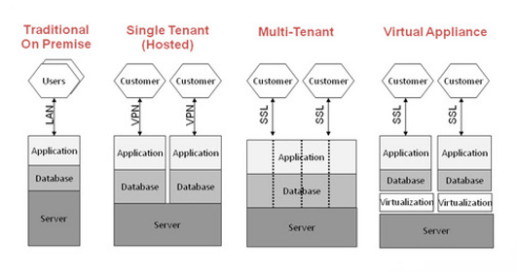
Multitenancy
Notes:
Service multiple customers from the same physical resources, by securely separating the resources on logical level.

Slide 14
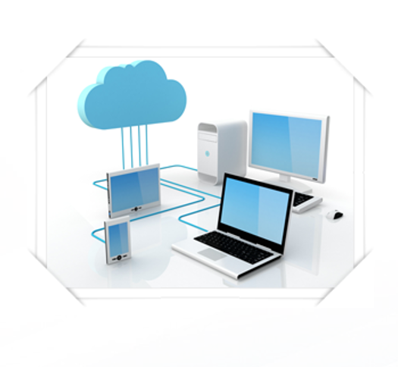
Ubiquitous access
Notes:
Cloud computing resources are accessible over the network, supporting heterogeneous client platforms.

Slide 15
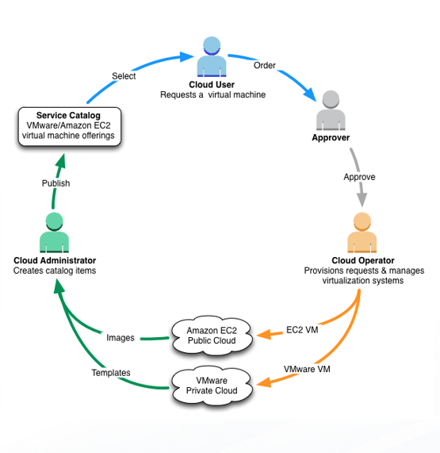
On-demand Self-service
Notes:
Users are able to provision cloud computing resources without requiring human interaction.

Slide 16
Cloud Computing : Characteristic
On-demand usage : Users are able to provision cloud computing resources without requiring human interaction.
Ubiquitous access : Cloud computing resources are accessible over the network, supporting heterogeneous client platforms.
Multi-tenancy : Service multiple customers from the same physical resources, by securely separating the resources on logical level.

Slide 17
Cloud Computing : Characteristic (cont.)
Elasticity : Resources are provisioned and released on-demand and/or automated based on triggers or parameters.
Measured usage : Resource usage are monitored, measured, and reported (billed) transparently based on utilization.
Resiliency : Automatically detect and recover from failure.
Cloud software takes full advantage of the cloud paradigm by being service oriented with a focus on statelessness, low coupling, modularity, and semantic interoperability.

Slide 18
Cloud Computing : Two different Model
Cloud computing refers to applications and services that run on a distributed network using virtualized resources and accessed by common Internet protocols and networking standards. It is distinguished by the notion that resources are virtual and limitless and that details of the physical systems on which software runs are abstracted from the user.

Slide 19
Cloud Computing : Two different Model (cont.)
Two Different classes of clouds:
Deployment model tells where the cloud is located and for what purpose. Public, private, community, and hybrid clouds are deployment models.
Service model describes the type of service that the service provider is offering. Software as a Service, Platform as a Service, and Infrastructure as a Service—the SPI model.

Slide 20
Cloud Computing : Two different Model (cont.)
Cloud computing makes the long-held dream of utility computing possible with a pay-as-you-go, infinitely scalable, universally available system. With cloud computing, you can start very small and become big very fast.

Slide 21
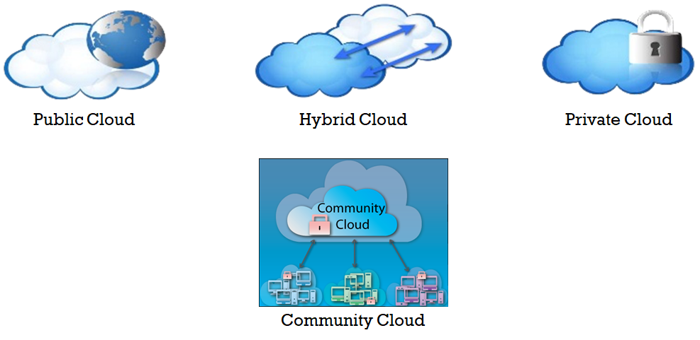
Deployment Models

Slide 22
Cloud Computing : Deployment Models
Public clouds provide service to any paying customer:
Amazon S3: store arbitrary datasets, pay per GB-month stored
Amazon EC2: upload and run arbitrary OS images, pay per CPU hour used
Google App Engine / Compute Engine: develop applications within their App Engine framework, upload data that will be imported into their format, and run

Slide 23
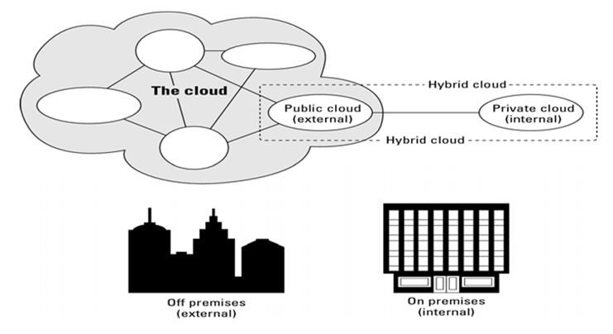
Deployment Models

Slide 24
Community Cloud
A community cloud in computing is a collaborative effort in which infrastructure is shared between several organizations from a specific community with common concerns (security, compliance, jurisdiction, etc.), whether managed internally or by a third-party and hosted internally or externally.

Slide 25
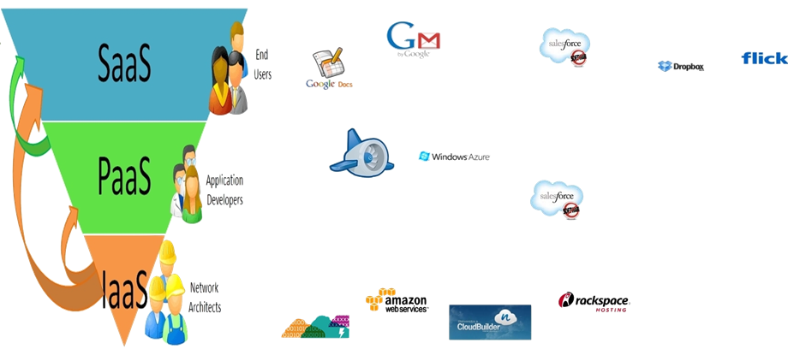
Service Models

Slide 26
Service Models: IAAS
Infrastructure as a Service: IaaS provides virtual machines, virtual storage, virtual infrastructure, and other hardware assets as resources that clients can provision.
The IaaS service provider manages all the infrastructure, while the client is responsible for all other aspects of deployment such as operating system, applications, and user interactions with the system.

Slide 27
Service Models: PAAS
Platform as a Service: PaaS provides virtual machines, operating systems, applications, services, development frameworks, transactions, and control structures.
The service provider manages the cloud infrastructure, the operating systems, and the enabling software. The client can deploy its applications on the cloud infrastructure or use applications that were programmed using languages and tools supported by PaaS service provider. Thus, the client is mere responsible for installing and managing the deployed application.

Slide 28
Service Models: SAAS
Software as a Service: SaaS is a complete operating environment with applications, management, and the user interface.
In SaaS model, the application is provided to the client through a thin client interface (a browser, usually), and the customer's responsibility begins and ends with entering and managing its data and user interaction. Everything from the application down to the infrastructure is the vendor's responsibility.

Slide 29
Service Models
The three different service models taken together have come to be known as the SPI model of cloud computing. Many other service models have been mentioned: StaaS, Storage as a Service; IdaaS, Identity as a Service; CmaaS, Compliance as a Service; and so forth. However, the SPI services encompass all the other possibilities.

Slide 30
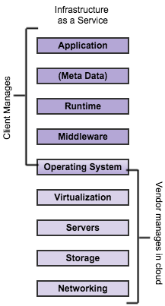
Cloud Computing : Service Models
Infrastructure as a Service (IaaS) solution should include vendor-managed network, storage, servers, and virtualization layers for a client to run their application and data on.
Examples: Amazon Web Services (AWS), Microsoft Azure, Google Compute Engine (GCE), Joyent
Use-Case: Extends current data center infrastructure for temporary workloads (e.g. increased Christmas holiday site traffic)

Slide 31
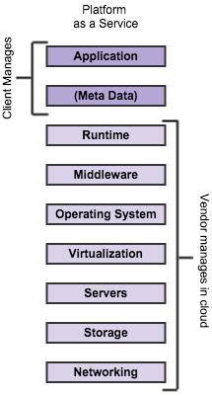
Cloud Computing : Service Models
Platform as a Service (PaaS) builds on top of infrastructure as a service adding vendor-managed middleware such as web, application, and database software.
Examples: Apprenda
Use-Case: Increases developer productivity and utilization rates while also decreasing an application’s time-to-market

Slide 32
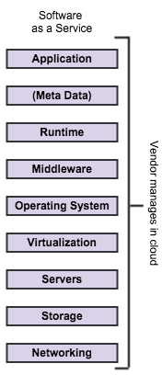
Cloud Computing : Service Models contd.
Software as a Service (SaaS) again builds on top of that, most of the time adding applications that implement specific user functionality such as email, CRM, or HRM.
Examples: Google Apps, Salesforce, Workday, Concur, Citrix GoToMeeting, Cisco WebEx
Use-Case: Replaces traditional on-device software

Slide 33
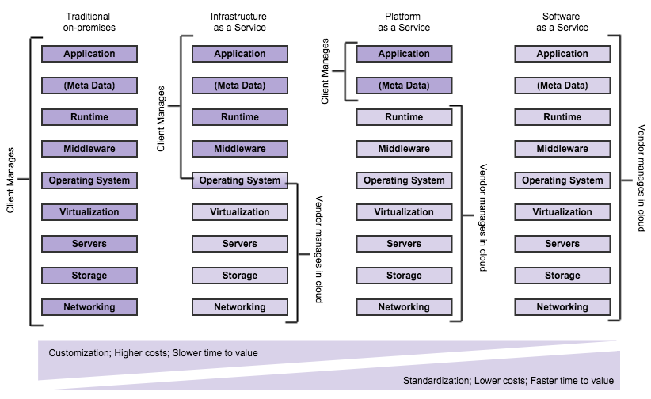
Cloud Computing : Service Models contd.

Slide 34
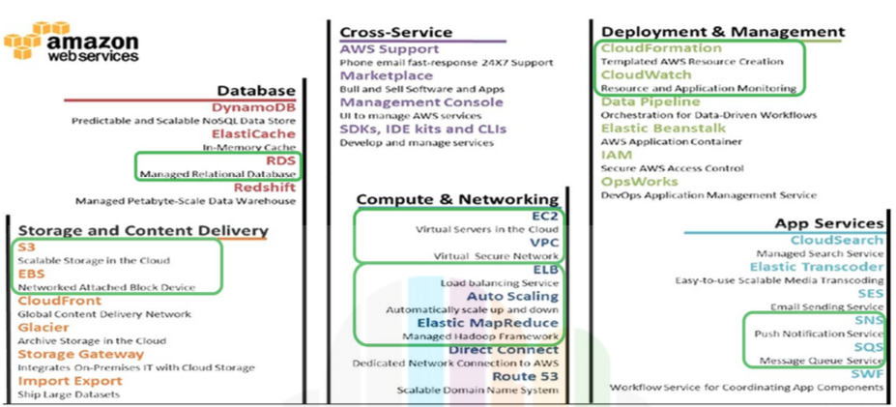
Case Study: Cloud Provider Amazon

Slide 35
Some Amazon S3 Use Cases
Content storage and distribution
Serve static files or whole websites from s3 directly
Better scalability for webserver tier.
Reduce ‘data gravity’, low I/O in the server, all HTTP
Fine-grained access control to buckets.
Backup, archiving and disaster recovery.
Even if Amazon Glacier is a cheaper option.
… but it’s not a Content Distribution Network.
Does not optimize routing for lowest latency.
Is not optimized for content streaming.
That’s why Amazon Cloudfront exists.

Slide 36
The cost of Amazon S3
Main reason to use S3: price
Example: 1 TB stored, modified 100 GB per month
Storage cost: $85 / month
Data transfer (upload): $0
Data transfer (download): $12 ($0.12 / GB)
A cheaper option: reduced redundancy (99.99 % instead of 99.99999999 %)
Storage cost: $68
Even Cheaper, but just for backups (very limited functionalities): Glacier
Storage cos: %10

Slide 37
Case Study: Cloud Consumer Viber
Launched in 2011
Acquired by Japanese e-commerce platform Rakuten in February, 2014 for a tidy sum of $900 million
Have over 300 million users, growing at 1 million a day, according to statistics of 2014
Have gone already through three generations :
Initially –
In 2011, had only few thousand users
Used in-memory in-house database
2nd Generation –
1 MongoDB cluster with 150 servers (master and two slaves)
3 Redis cache clusters with a total of around 150 servers.
Redis had no support for sharding, so they wrote their own frontend which dealt with sharding.
Moved all of its application servers to Amazon Web Services
Things that went badly:
MongoDB could only managed tens of thousands of operations per second, they needed hundreds of thousands. Large datasets cause MongoDB problems.
MongoDB does not scale well with many application servers (it handles each connection in a separate thread, which ends up being very wasteful of CPU and memory).
The in-house sharding frontend for Redis wasn’t easily scalable (it could only handle increasing the number of servers by factors of two).

Slide 38
Case Study: Cloud Consumer Viber cont.
Current Architecture (3rd Gen):
Have opted for small nodes (about 60GB RAM per node).
Have separate nodes for different types of operations (reads vs. sets vs. appends).
400 application server with AWS.
7 Couchbase clusters, each with up to 60 nodes
0-2 replicas, XDCR and external backups
Used Amazon S3
They have a total of 150 Couchbase servers (less than half the number needed with MongoDB and Redis).
Source : here and here

Slide 39
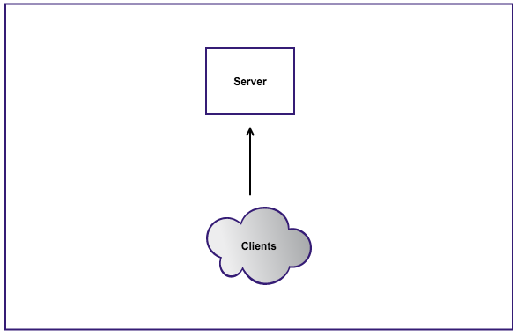
Case Study: Cloud Consumer Dropbox
Mid 2007
Almost 0 users

Slide 40
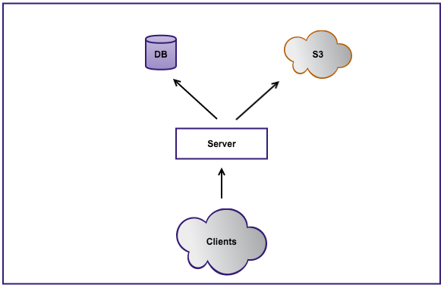
Case Study: Cloud Consumer Dropbox cont.
Late 2007
Fast Changing environment, resourcing are growing at the same time with the demand
The server runs out of space and becomes overloaded
Put the data on S3
Use MySQL

Slide 41
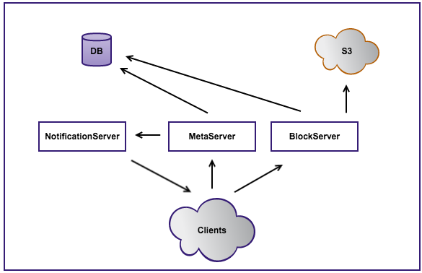
Case Study: Cloud Consumer Dropbox cont.
Early 2008
50k users
The server is split into 2 servers:
Metaserver: doing all the metadata calls
Blockserver: hosting all the files’ contents

Slide 42
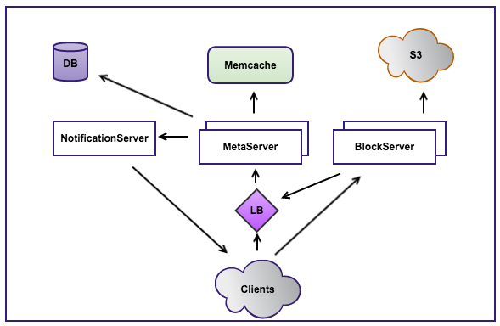
Case Study: Cloud Consumer Dropbox cont.
Late 2008
100k users
Need of adding more meta and block servers
Only one DB -> Add Memcache to avoid DB scaling issues
Load Balancing methods to optimize resources, minimize response time, avoid overload of resources

Slide 43
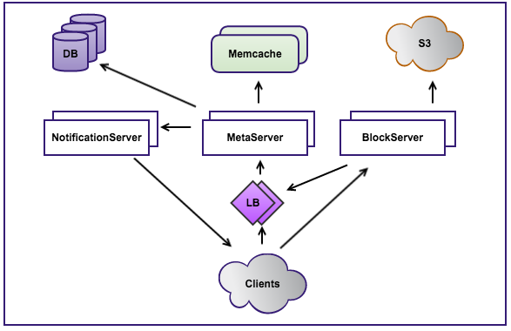
Case Study: Cloud Consumer Dropbox cont.
Early 2012
50M users
Use of several DBs
Large use of Load Balancing

Slide 44
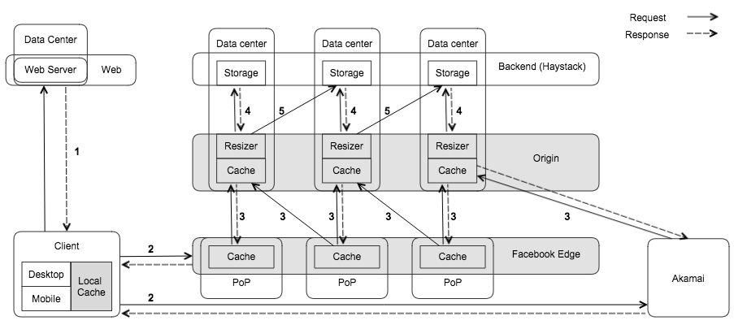
Case Study: Facebook

